Slide 1
CSE417: WEB ENGINEERING
Daffodil International University

Slide 2
You Will Be Able To
Understand and Apply Layout
To design your webpage efficiently

Slide 3
Contents
Layout
  HTML Layout - Using <div> tag
  HTML Layout - Using Tables
  CSS Box Model
  Others

Slide 4
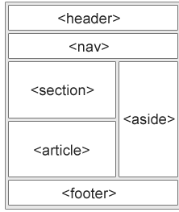
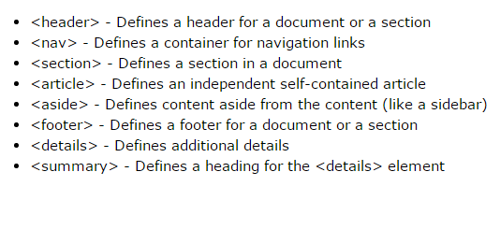
Website Layout Using HTML5
HTML5 offers new semantic elements that define different parts of a web page:

Slide 5
HTML Layouts , <div> tag
Layout
A webpage layout is very important to give better look to your website.
It takes considerable time to design a website's layout with great look and feel.
you can create a good layout using simple HTML tables or division tags in combination with other formatting tags.
<div> tag
The <div> tag defines a division or a section in an HTML document.
The <div> tag is nothing more than a container unit
Used to group block-elements to format them with CSS and layout a web page.
By default, browsers always place a line break before and after the <div> element. However, this can be changed with CSS.

Slide 6
HTML <div> tag
Probably the most common use for the <div> tag is for navigation bars
<div> is a block-level tag (like a paragraph)
Can contain any number of block-level tags or inline tags
  Can group paragraphs, with lists, with tables, e.g.
<div> tags will most often be used inside the <body> tag and inside other <div> tags
  Can be nested
Often <div> tags are modified using the id attribute, rather than class
  You only have one navigation bar
  The properties you want for a certain portion of your page are unique
Can't place a <div> tag inside a paragraph

Slide 7
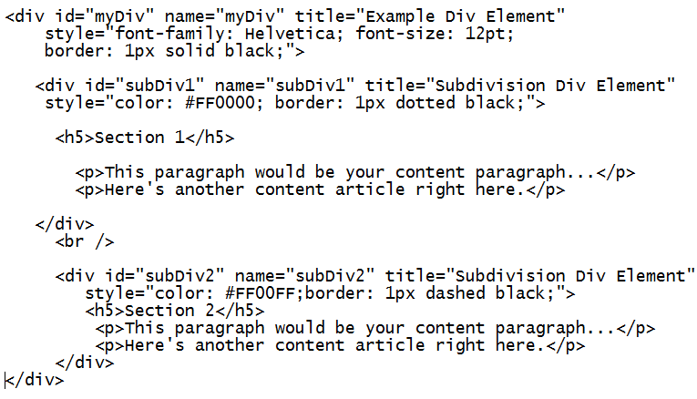
HTML <div> tag

Slide 8
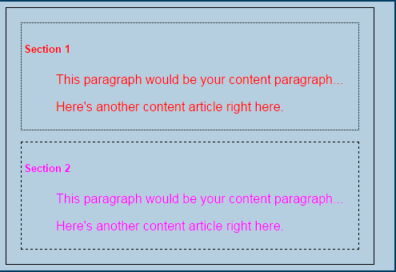
HTML <div> Tag

Slide 9
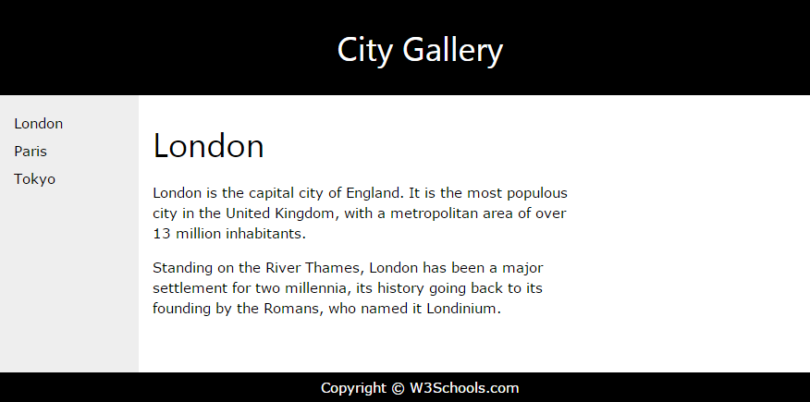
Website Layout

Slide 10
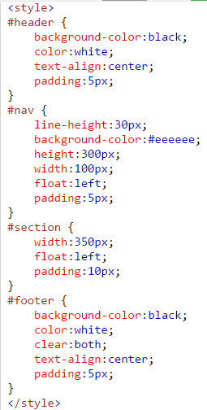
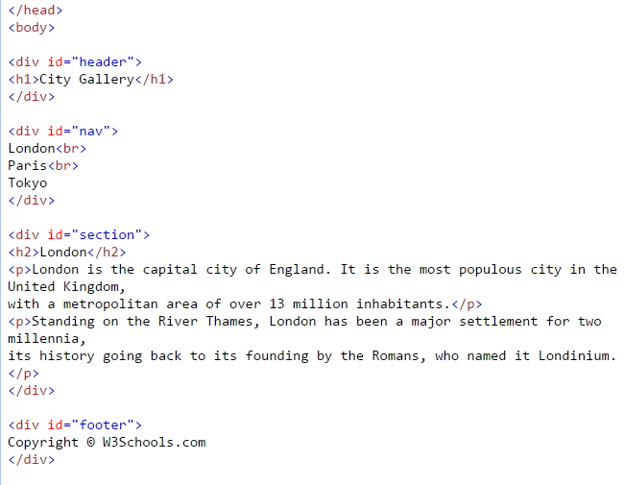
Website Layout

Slide 11
<span> tag
Inline style element
Changes the style of the text it encloses.
Useful for modifying a specific portion of text
But without any style attributes, the <span> tag won't change the enclosed items at all
<p>This one is <span style="color:red; font-weight:bold">only a test</span>.</p>
<p>This one is another <span style="font-size:32px; font-weight:bold">TEST</span>.</p>

Slide 12
Differences between the <span> and <div> tag
<span> doesn't do any formatting of it's own.
The <div> tag acts includes a paragraph break
  because it is defining a logical division in the document.
The <span> tag simply tells the browser to apply the style rules to whatever is within the <span>
a span element is in-line whereas div (division) element is block-line
<span> is used for a small chunk of in-line HTML but <div> tag is used to group larger chunks of code.

Slide 13
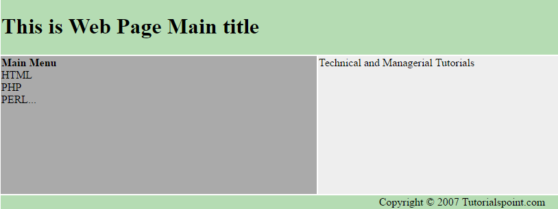
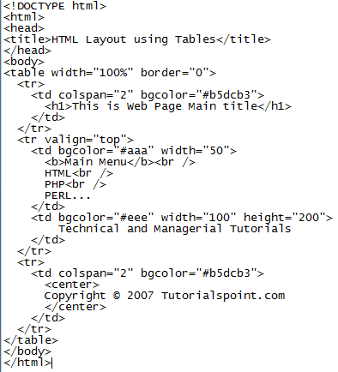
HTML Layout - Using Tables
The simplest way of creating layouts is using HTML <table> tag.
Tables are arranged in columns and rows, can be utilized
BUT NOT recommend for complex layout!!!

Slide 14
The CSS Box Model
All HTML elements can be considered as boxes. In CSS, the term "box model" is used when talking about design and layout.
The CSS box model is essentially a box that wraps around every HTML element. It consists of: margins, borders, padding, and the actual content.
Explanation of the different parts:
  Content - The content of the box, where text and images appear
  Padding - Clears an area around the content. The padding is transparent
  Border - A border that goes around the padding and content
  Margin - Clears an area outside the border. The margin is transparent

Slide 15
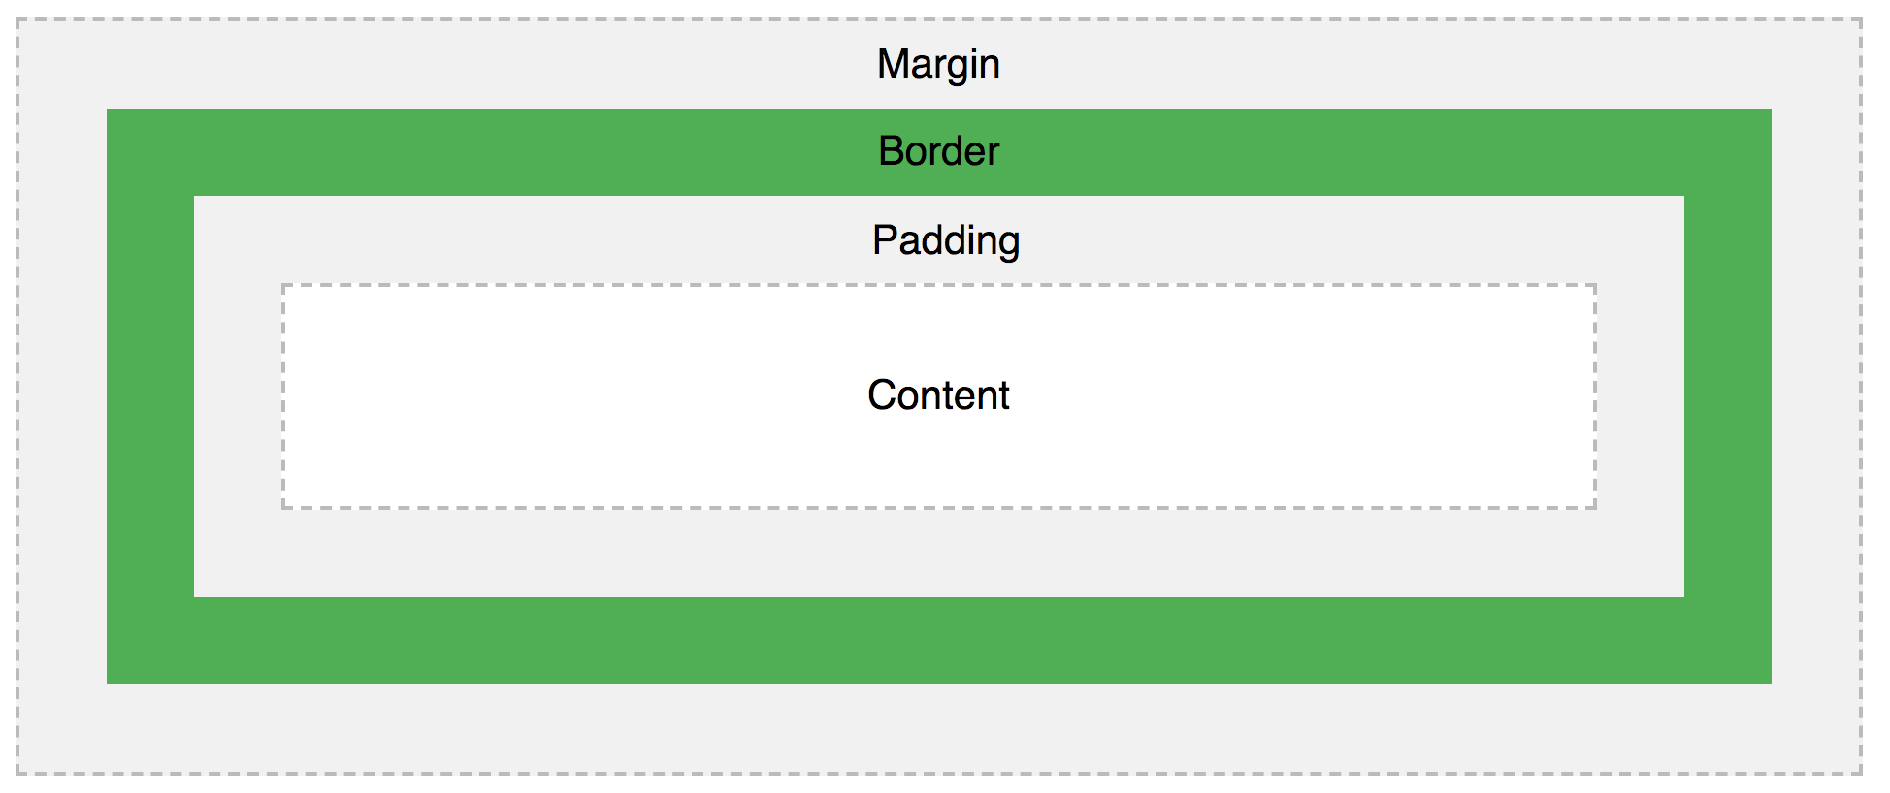
The CSS Box Model

Slide 16
More CSS properties
CSS Border Properties
  The CSS border properties allow you to specify the style, width, and color of an element's border.
  p {border-style: solid;}
CSS Margins
  The CSS margin properties are used to create space around elements, outside of any defined borders.
  With CSS, you have full control over the margins. There are properties for setting the margin for each side of an element (top, right, bottom, and left).
  p {
  margin-top: 100px;
  margin-bottom: 100px;
  margin-right: 150px;
  margin-left: 80px;
  }
  //shorthand:
  margin: 25px 50px 75px 100px; //clockwise: top right bottom left

Slide 17
More CSS properties
CSS Padding
  Gspace around an element's content, inside of any defined borders.
  There are properties for setting the padding for each side of an element (top, right, bottom, and left)
      div {
      padding-top: 50px;
      padding-right: 30px;
      padding-bottom: 50px;
      padding-left: 80px;
      }
      //is there a shorthand to this?
CSS Setting height and width
  set the height and width of an element.
  dnot include padding, borders, or margins. It sets the height/width of the area inside the padding, border, and margin of the element.’
      div{
      height: 200px;
      width: 50%;
      }

Slide 18
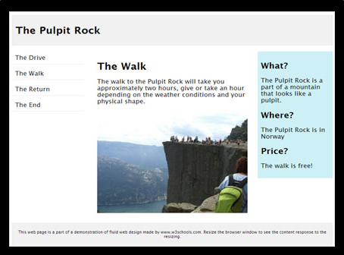
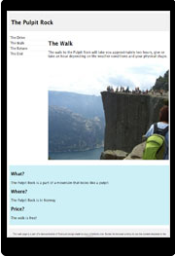

Responsive Web Design
Responsive Web Design makes your web page look good on all devices (desktops, tablets, and phones).
Responsive Web Design is about using CSS and HTML to resize, hide, shrink, enlarge, or move the content to make it look good on any screen:

Slide 19
Exercise
One example of each
  Simple left-nav bar
  top and side nav bars
  Inline block
  Overflow
  Dropdown
READINGS/Practice
  M Schafer: Ch. 12-18
  https://www.w3schools.com/css
  https://www.w3schools.com/css/css_boxmodel.asp
  https://www.w3schools.com/css/css_website_layout.asp

Slide 20
Acknowledgement
This module is designed and created with the help from following sources-
  https://cgi.csc.liv.ac.uk/~ullrich/COMP519/
  http://www.csc.liv.ac.uk/~martin/teaching/comp519/
  Anup Majumder, Jahangirnagar University

